Slide 1



Department of Artificial Intelligence and Data Science
2311CSC301R Object Oriented Programming in JAVA
Review I
TITLE :College Feedback Logger
Team No.:
Team Members:
Aakash S - (310624243001)
Deepakram V - (310624243036)
Subject Faculty:
Mrs.K.Amsavalli
Assistant Professor/AI&DS

Slide 2
Introduction
In academic institutions, understanding student feedback is essential for continuous improvement.
Our project bridges the gap between outdated manual feedback and a modern, digital solution.
Why Feedback Matters
Student feedback helps improve teaching quality, infrastructure, and campus experience
Digitizing the Process
We replace slow paper forms with a secure, interactive web portal.
Adding Sentiment
Our system detects emotional tone (positive/negative/neutral) in feedback.
User-Friendly & Secure
Simple UI, role-based access, and structured data storage using SQLite.

Slide 3
Problem Statement
Colleges often face challenges with inefficient feedback systems that lack actionable insights.
Unstructured Collection:
Manual forms lead to scattered, hard-to-analyze data..
Maintenance Nightmare:
Paper logs are hard to store, search, and summarize.
Missing Emotional Context:
No sentiment tagging to understand student mood..
Need for Security & Structure:
A secure, role-based digital system is essential.

Slide 4
Objectives
Our mini-project focuses on creating a robust, functional, and user-friendly solution using core Java principles.
Web-Based Interface:
HTML/CSS/JS frontend with responsive design.
Sentiment Categorization:
Keyword-based logic to detect feedback tone
CSV Export :
Admin can download structured feedback reports..
Protected Access:
Students and admins have separate login flows

Slide 5
Existing System& Limitations
Traditional feedback systems fall short in speed, structure, and insight.
Manual Forms:
Collecting paper feedback takes a lot of time and manual effort. Staff must read and tally each form by hand, causing delays in analysis.
No Mood Tagging:
Lacks capability for automated analysis, specifically sentiment analysis.
Data Silos:
Feedback is not centralized or exportable.
No Role Control:
Admins lack secure access to analytics.

Slide 6
Proposed System
Core Modules:
Student & Admin Login
Feedback Form with Category & Rating
Sentiment Detection
CSV Export
Algorithm Used:
Keyword-based sentiment tagging
Advantages:
Easy UI
Real-time feedback logging
Secure access
Structured export
Limitations:
No cloud deployment
Basic sentiment logic
No JWT or charts (yet)

Slide 7
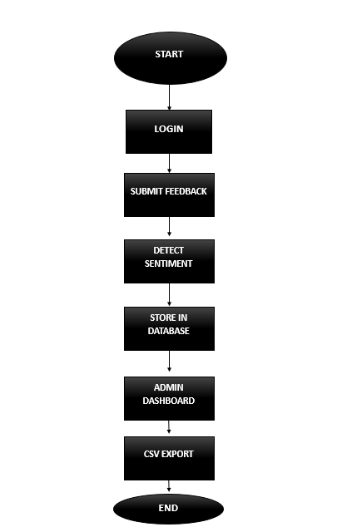
Flow Diagram

Slide 8
Technology Stack
We utilized core Java libraries for application development and standard local file structures for persistence.
Frontend:
HTML, CSS, JavaScript
Backend:
Node.js, Express
Database:
SQLite
Libraries:
dotenv, csv-writer
Storage:
Local .db file and downloadable CSV

Slide 9
Deliverables & Outcomes
Full-Stack Feedback Portal:
Role-based access, sentiment tagging, CSV export
Sentiment Detection Module:
Classifies feedback tone instantly
Admin Dashboard:
View all feedbacks with stats
Multilingual UI:
Tamil/English toggle for accessibility

Slide 10
References
Node.js Documentation:
https://nodejs.org/api/all.html
Express.js Guide:
https://devdocs.io/express
SQLite Docs:
https://sqlite.org/docs.html
CSV-writer Library:
https://www.npmjs.com/package/csv-writer
10

Slide 11
Thank You
11

